Slide 1
Zymsoft
Zachary Eichler, Yash Patel, Matthew Erenberg | Capstone 2019 | Sheridan College

Slide 2



Team Overview
Zachary Eichler
Leadership
Organization
Problem Solving
Research
Yash Patel
System analysis diagramming
User interface design
Front-End Development
Matthew Erenberg
Quality assurance
Debugging/testing
Communication
Backend development

Slide 3
Mission Statement
“Make Technology an asset not a liability”

Slide 4
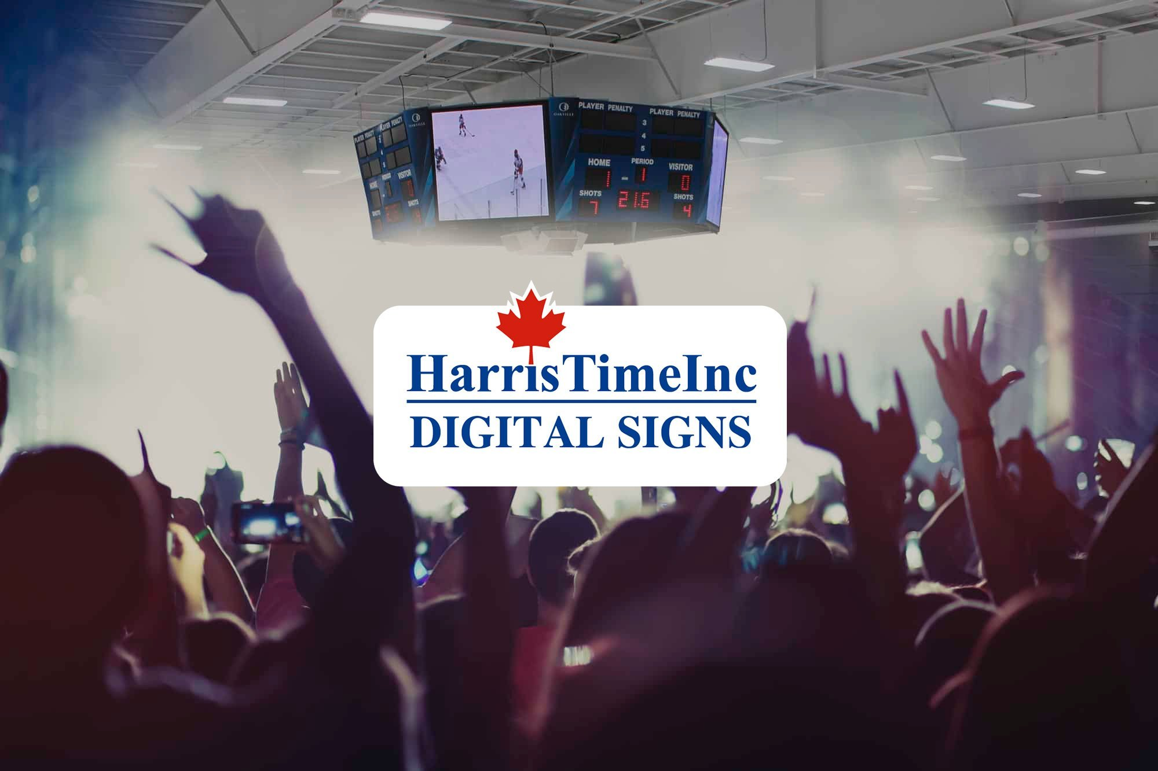
Our Client
Harris Time is the premiere Canadian Manufacturer of sport timing and scoreboard equipment
Products Include: Scoreboards, Auxiliary Clocks, Digital Sign Solutions
Services Include: Scoreboard customization, on-site service, retrofitting of existing scoreboards, scoreboard and shot clock rental.

Slide 5
What might you want to show on a scoreboard?
What is necessary? What is a luxury?
Notes:
This is the question that your experiment answers

Slide 6
Our Project – Digital LED Scoreboard System
Scoreboard system for basketball gymnasiums / arenas
Lightweight, more affordable solution than traditional scoreboard system
All media, live video, stats, info on one screen
Screen display controlled by 2 mobile applications

Slide 7
System Vision
Capabilities:
Show live game video
Show advertisements, fan engagement media
Show player and team stats
Show game information with up to date score and time
4 Main Components:
Scorekeeper mobile app
Producer mobile app
Windows scoreboard control app
Web API and SQL Database Server

Slide 8
System Vision – Continued
Risks:
Communication between different software platforms
Dependency on 3rd party library
Deployment requires substantial hardware installation and configuration
System Benefits:
Increased attendance due to better fan experience
Higher fan engagement
Many operations are automated, reducing required manpower
More advertising and revenue opportunities

Slide 9
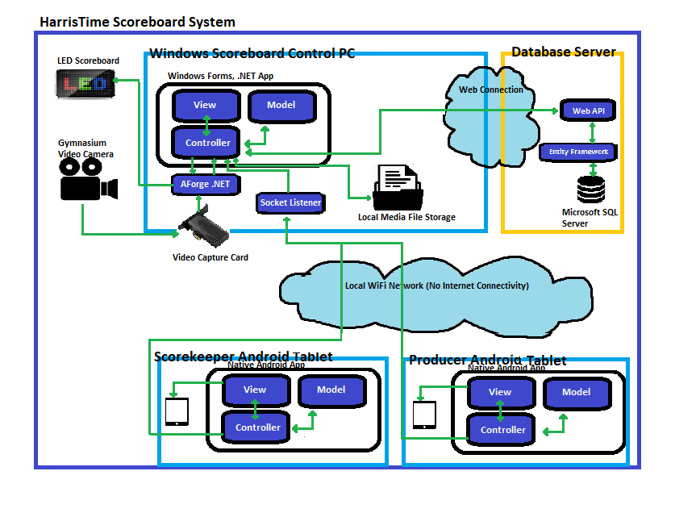
System Architecture
Main frameworks: .NET 4.6+, .NET Core 2.1+, AForge .NET, Native Java Android, Entity Framework, Web API Core, Microsoft SQL Server
Design patterns: MVC

Slide 10
UI Prototype
Scorekeeper Mobile Application
Notes:
This is the question that your experiment answers

Slide 11
Login Proof of Concept
Windows Scoreboard Control App – Join league
Notes:
Establish hypothesis before you begin the experiment. This should be your best educated guess based on your research.

Slide 12
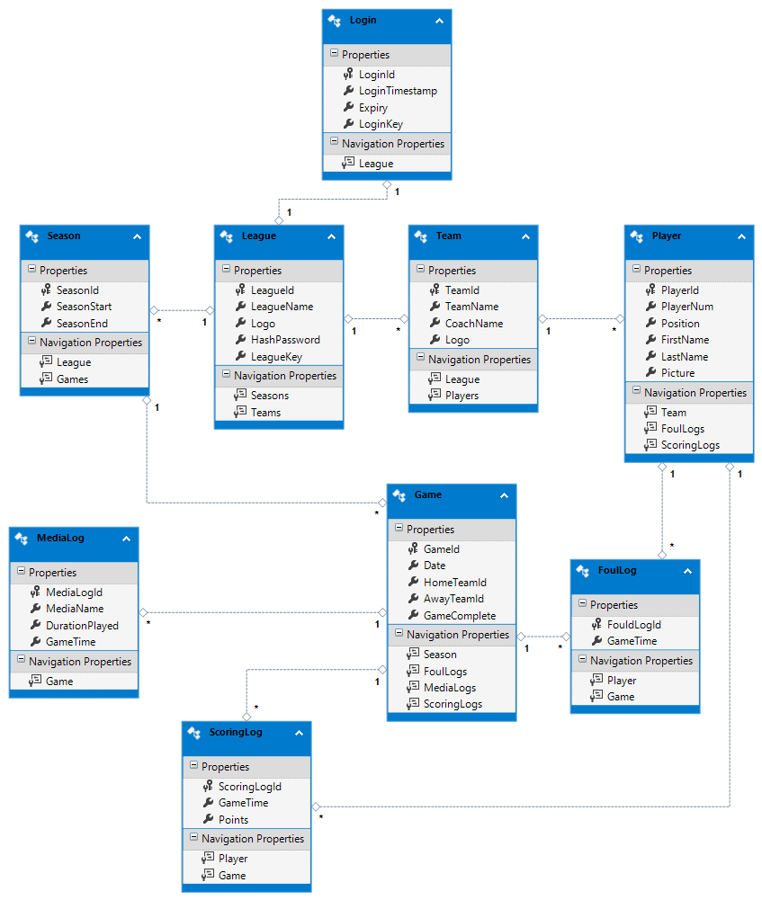
Database Model
- Users are supplied a unique ID on login success that is required for all non-read web API functions

Slide 13
Prototyping – Risk Identification and Mitigation
User Interface is intuitive and easy to use
- Original UI designs contained many user inputs on every screen
- After prototyping UI seemed cluttered and overwhelming
- Child screens for similarly grouped functions were created to simplify UI
Secure communication between windows scorekeeper client apps and database server
- Originally planned to have client apps make direct connection to SQL server
- Only non-client side functional control would be through stored procedures
- Realized web API middleware between client and server would solve many problems

Slide 14
Conclusion
Traditionally, scoreboard systems have been analogue boards controlled by serial import controllers.
With this project, we aim to catapult Harris Time into the future, and ahead of their competitors with a modern, web integrated digital scoreboard solution!
Thank you for your patience during our presentation!

Slide 15
Questions / Comments?
Notes:
Establish hypothesis before you begin the experiment. This should be your best educated guess based on your research.

